Slide 1
Unit 3: Week 1
Grade 1

Slide 2
Copyright © Savvas Learning Company LLC. All Rights Reserved.
This publication is protected by copyright, and permission should be obtained from the publisher prior to any prohibited reproduction, storage in a retrieval system, or transmission in any form or by any means, electronic, mechanical, photocopying, recording, or otherwise. For information regarding permissions, request forms, and the appropriate contacts within the Savvas Learning Company Rights Management group, please send your query to:
Savvas Learning Company LLC, 15 East Midland Avenue, Paramus, NJ 07652
or
k12learningpermissions@savvas.com
myView Literacy® is an exclusive trademark of Savvas Learning Company LLC in the U.S. and/or other countries.

Slide 3
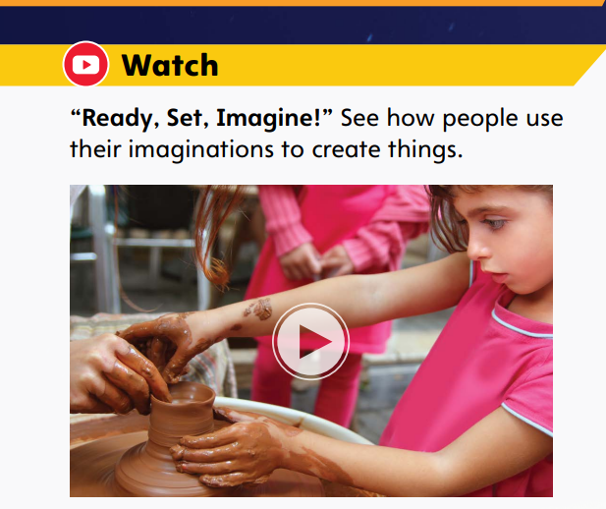
Page 6
Introduce the Unit
Essential Question: How can we use our imaginations?
When do you use your imagination?
What things do you like to imagine?
Notes:
Introduce the Essential Question for Unit 3: How can we use our imaginations? Tell students they will read many texts to learn about the ways we use our imaginations.
Watch the Unit Video Tell students that a video gives information through sound and pictures. Have students listen to and watch the Unit 3 Video, “Ready, Set, Imagine!” Click Path: Table of Contents -> Unit 3: Imagine That-> Unit 3: Introduction
Tell partners to discuss how they use their imaginations. Use the following questions to guide their discussions.
When do you use your imagination?
What things do you like to imagine?

Slide 4
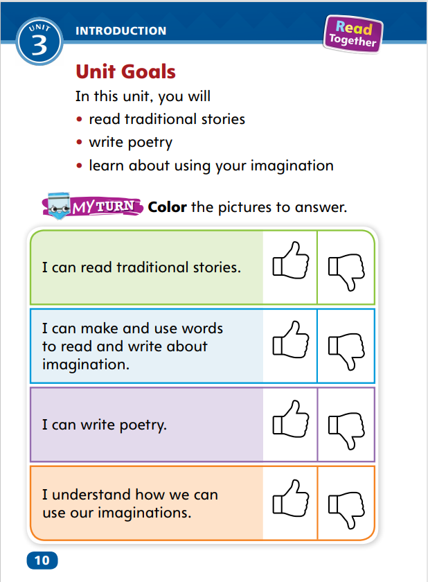
Page 10
Unit Goals
Turn to page 10 in your Student Interactive.
Color the “Thumbs Up” or the “Thumbs Down” for each goal.
Notes:
Read aloud the bulleted list of goals on p. 10 in the Student Interactive.
Have students color the “thumbs up” if they feel they have already accomplished the goal, or the “thumbs down” if they think they have more to learn.
Students will revisit this page in Week 6.

Slide 5
Page 11
Academic Vocabulary
Expand: You can create an illustration using crayons.
Ask: What is something you create in art class?
Expand: When you imagine something, you picture it in your mind.
Ask: What things or activities do you like to imagine?
Expand: I suppose it is a good idea to study hard for a test.
Ask: What do you suppose the temperature is when it is snowing?
Expand: If something is possible, that means you are able to do it.
Ask: What are some things that are and are not possible for you to do right now?
Notes:
Academic Vocabulary is language used to talk about ideas. Explain that as students work through the unit, they will learn and use these academic words to talk about our imaginations.
Read aloud the paragraph on p. 11 in the Student Interactive. Then use the EXPAND and ASK questions for each word.
Have students respond, or say something in reply to someone else, using the newly acquired Academic Vocabulary as appropriate.
Have partners use the Academic Vocabulary words as they discuss what they could create with the materials in the picture.

Slide 6
Lesson 1

Slide 7
Page 14
Phonological Awareness
Notes:
Point to the picture of an inch on a ruler on p. 14 in the Student Interactive. Say: This is a picture of an inch on a ruler. Listen carefully as I say the sounds in inch: /i/ (pause) /n/ (pause) /ch/. Now let’s say the sounds together: inch.
Repeat with the sounds for the pictures of whale, /hw/ /ā/ /l/; match, /m/ /a/ /ch/; and phone, /f/ /ō/ /n/.
Practice segmenting and blending these words: pinch, which, white, patch, hitch, and photo. Say a word. Have students say the word. Then have students segment the sounds and then blend them to say the word again.

Slide 8
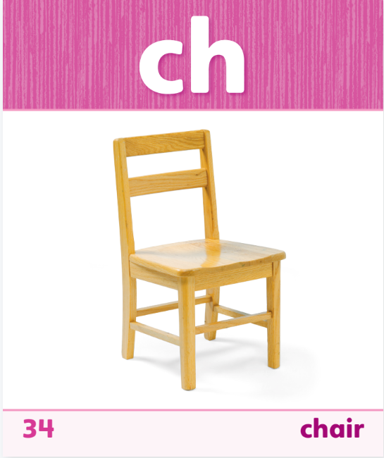
Page 14
Phonics
phone
whale
watch
Read the words on page 14 in your Student Interactive.
Notes:
Tell students that when two letters spell one sound, the letters are called a consonant digraph, like the letters sh spell the sound /sh/.
Display Sound-Spelling Card 34 (chair) and read the word on the card aloud. In the word chair, the sound /ch/ is spelled ch.
Display Sound-Spelling Card 46 (phone) and read the word aloud. In the word phone, the sound /f/ is spelled ph.
Display Sound-Spelling Card 52 (whale) and read the word aloud. In the word whale, the sound /hw/ is spelled wh.
Tell students that some digraphs can appear at the ends of words too. Write much and graph on the board and read the words. Point out the digraphs ch and ph in these words, and say: The sound /ch/ in much is spelled ch and the sound /f/ in graph is spelled ph.
Display Sound-Spelling Card 49 (watch) and read the word aloud. In the word watch, the sound /ch/ is spelled tch. In this word, there are three letters that spell one sound. The letters -tch are called a trigraph.
Write the following words and have students decode them: whale, graph, white, ditch, chip, such, match, hatch, chat.
Direct students to the bottom of p. 14 in the Student Interactive. Have them practice decoding each word.

Slide 9
High-Frequency Words
good
no
put
round
said
Notes:
Write the high-frequency words good, no, put, round, said.
Tell students to practice these words.
Point to and read each word.
Spell each word and read it again.
Have students spell and say the words with you.

Slide 10
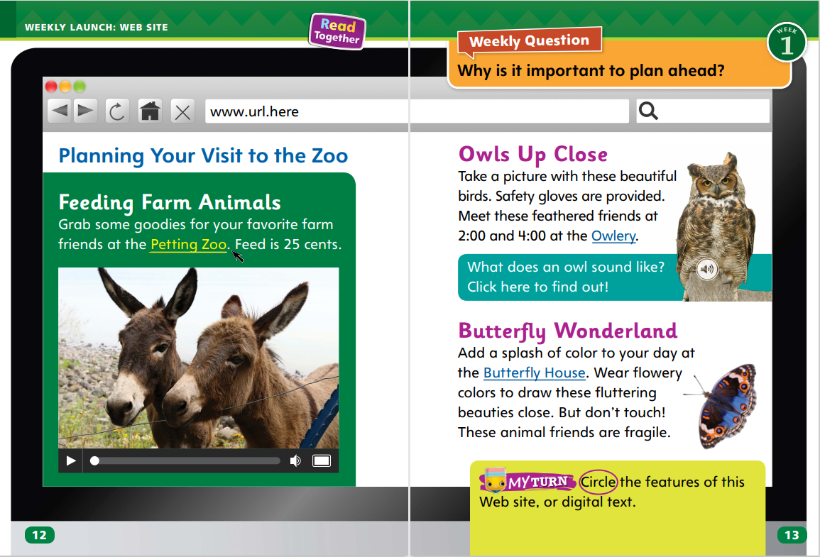
Page 12,13
Interact with Sources
How does visiting a Web site help you plan ahead? Circle features of digital text.
Notes:
Remind students of the Essential Question for Unit 3: How can we use our imaginations? Point out and read the Weekly Question: Why is it important to plan ahead?
Have students follow along in their Student Interactive, pp. 12–13, as you read aloud the Website “Planning Your Visit to the Zoo.”
Explain that a Website is a type of digital text, or text that you can read on a computer or other device. A digital text can have sound, video, and words.
Display different features of a Website for students, such as hyperlinks, address bar, Website address, a refresh button, and a video play button.
Lead a discussion about these different characteristics of digital texts and how to identify them.
Then place students in small groups and have them discuss what features they recognize on the Web site on pp. 12–13.
Ask students to discuss the content of the Web site. During the group discussions, encourage students to ask each other questions to clear up any confusion about the information on the Web site.
Display the following statements as ideas groups might discuss:
You might need to plan ahead to bring something with you.
You might need to plan ahead to get there on time.
Then ask: How does visiting the Web site help you plan ahead? Have each group reach a consensus on an answer and choose a representative to share the group’s answer with the class.
Have students interact with the source by circling the features of the text on pp. 12–13 that are part of a Web site. Guide students to recognize that these features are characteristics of digital texts.

Slide 11
Listening Comprehension
Beginning | Middle | End
Notes:
Tell students that you are going to read aloud a fable. Have students listen as you read “The Lion and the Mouse.” Tell students to be active listeners by looking at you as you read and picturing in their minds the characters and actions in the fable.
Have students listen actively for elements of a fable and ask and answer questions about key details in a text read aloud.
READ the entire text aloud without stopping for the Think Aloud callouts.
REREAD the text pausing to model Think Aloud strategies related to the genre.
Ask students: What events can you remember from the fable? Use a three-column chart to record student responses. Explain that these events make up the plot of the fable.

Slide 12
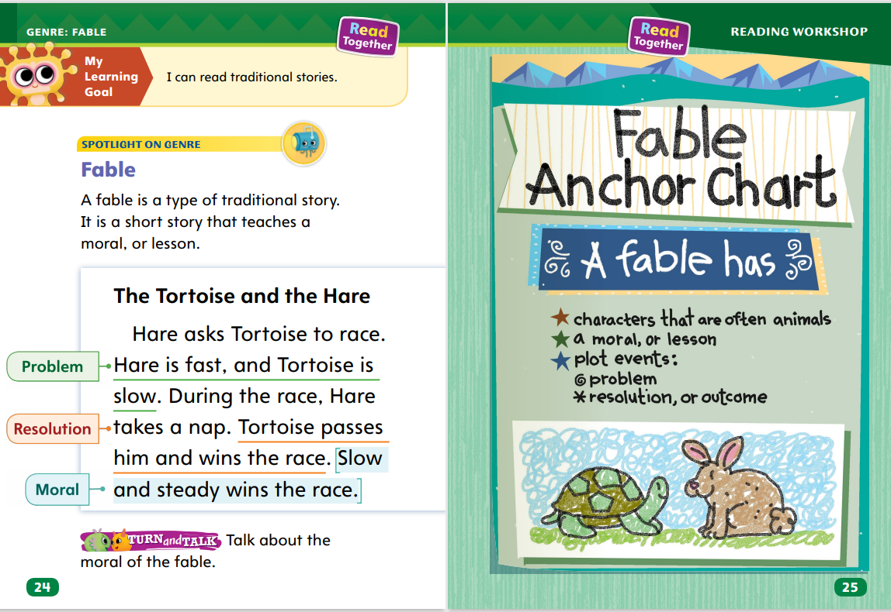
Page 24,25
Fable Qualities
Turn to page 24 in your Student Interactive.
Notes:
Tell students like other stories, a fable has a title. It also has a plot, or main events. These main events include a problem that needs to be solved as well as a resolution, or outcome. A fable usually has animal characters, and it always teaches a moral, or simple lesson, for the reader to learn.
Read the title. What can you guess about the story from the title?
Think about the plot of the story. What is the order of the events? What problem do the characters face? What is the resolution, or outcome?
What is the moral, or lesson, that this fable teaches?
Read the model “The Tortoise and the Hare” with students on p. 24 in the Student Interactive.
Then model how you can tell it is a fable. “The Tortoise and the Hare” is the title of this story. The title tells me the main characters are animals. The plot includes a problem: the animals are in a race. A moral, or lesson, is included at the end. I know that a story with animal characters and a simple moral at the end is a fable.”
Read the Anchor Chart on page. 25 in the Student Interactive together. Editable Anchor Chart Click Path: Table of Contents -> Reading Anchor Charts -> Unit 3 Week 1: fable Editable Reading Anchor Chart

Slide 13
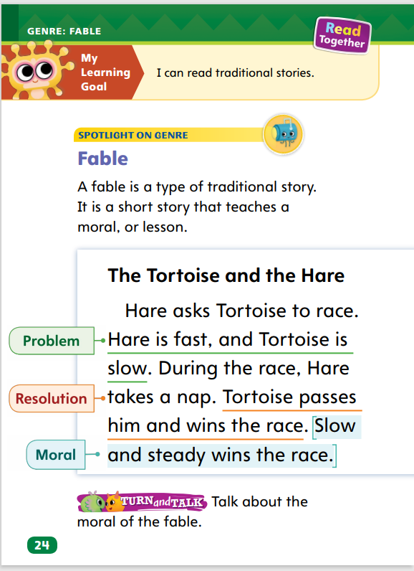
Page 24
Apply
Talk about moral of the “Tortoise and the Hare.”
Notes:
Have students talk with a partner about the moral of the fable “The Tortoise and the Hare” on p. 24 of the Student Interactive.

Slide 14
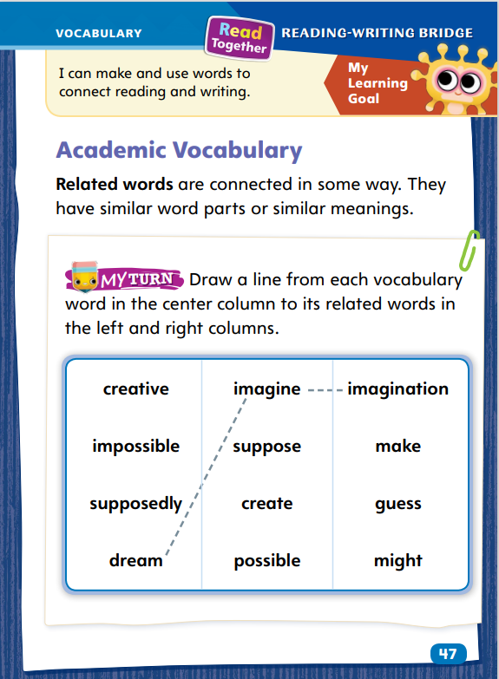
Page 47
Academic Vocabulary
Notes:
Remind students of the Academic Vocabulary for the unit: create, imagine, suppose, possible. Explain that related words are words that have a word part or meaning in common. We can often learn new words by recognizing that they are related to a word we already know.
Look for words that are related because they share a similar word part.
Ask yourself if the new word has a similar meaning to a word you already know. The words are related by their meanings..
Model an example: We are learning the word possible in this unit. I saw the word possibility in a book I’m reading, and it looks very similar to possible. They both have the letters p-o-s-s-i-b, so I think they are related. I also read the word likely. The word likely means that something will probably happen. I think that is a similar meaning to possible. I think the words are related because of their meanings.
Have students complete the activity on p. 47 in the Student Interactive.

Slide 15
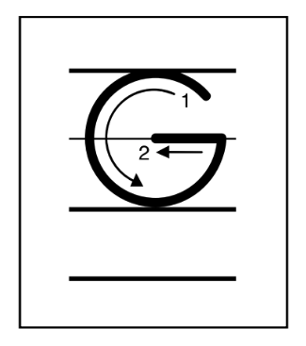
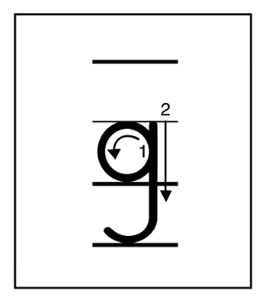
Handwriting
Notes:
Display uppercase and lowercase letters Gg.
Model how to write uppercase G using correct letter formation and slant. Have students practice writing the letter in the air with their fingers. Then repeat with lowercase g.
Have students use Handwriting p. 155 from the Resource Download Center to practice writing the uppercase and lowercase letters Gg. Click path: Realize -> Table of Contents -> Resource Download Center -> Handwriting Practice -> U3W1L1 Handwriting Practice

Slide 16
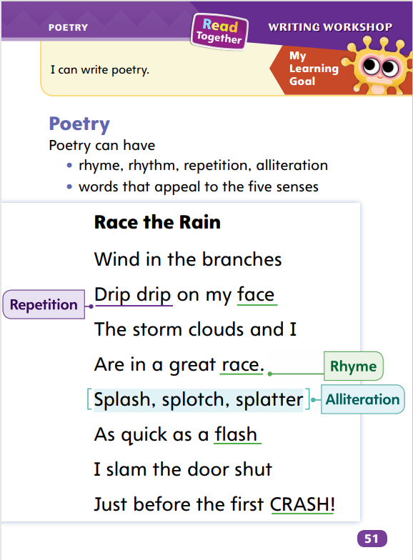
Page 51
Writing – Poetry
Turn to page 51 in your Student Interactive.
Notes:
Poetry is written differently than fiction or nonfiction. It looks different and sounds different. Poets compose poetry using rhyme, rhythm, repetition, and alliteration.
Rhyme is the use of words that have the same middle and ending sounds.
Rhythm is a pattern of strong beats.
Repetition is when a word is used more than once.
Alliteration is the repetition of a sound at the beginning of two or more words.
Tell students that they will be learning to compose poetry over the next few days. Today, they will focus on how poets compose rhyme, rhythm, repetition, and alliteration.
Direct students to p. 51 in the Student Interactive. Explain that this is a poem. Ask students to share anything they notice about the text.
Then read the introduction and explain the terms using the definitions in the Teaching Point. Say: I’m going to read the poem two times. Listen for examples of rhyme, rhythm, repetition, and alliteration.
Read the poem aloud once without stopping. Then read it again, pausing to discuss the elements. Use these prompts:
How do you know this is a poem?
What words does the poet repeat?
Did the poet write words that begin with the same sounds? What are they?
Read aloud additional poems from the poetry stack, guiding students to discuss how the author composed the poem. Focus on rhyme, rhythm, repetition, and alliteration.

Slide 17
Independent Writing
Write your own poem.
Share poetry characteristics you can identify.
Notes:
If students need additional opportunities to develop their understanding of poetry, they should read additional poems from the stack.
If students demonstrate understanding, they should begin composing their own poems. See the Conference Prompts on p. T82
Call on a few students to share the characteristics of poetry they can identify.

Slide 18
Spelling
1. A baby whale is called a calf.
2. He has food on his chin.
3. The worm was one inch long.
4. What do you think would be a good snack?
5. I will check in my pockets for a coin.
6. The player made a great catch.
7. Which movie would you like to see?
8. We saw a soccer match on Saturday.
9. The teacher said to bring more pencils.
10. The graph helps me see how the temperature has changed this month.
Notes:
Flexible Option
(Note: Move the orange boxes to cover each bold spelling word before you read aloud the words and sentences.)
Read aloud the words and sentences. Have students spell each word with digraphs, the trigraph -tch, and the two high-frequency words.
A baby whale is called a calf.
He has food on his chin.
The worm was one inch long.
What do you think would be a good snack?
I will check in my pockets for a coin.
The player made a great catch.
Which movie would you like to see?
We saw a soccer match on Saturday.
The teacher said to bring more pencils.
The graph helps me see how the temperature has changed this month.
Reveal the spelling word and have students check their work.

Slide 19
Language and Conventions
Go to the front of the class.
Verb? Subject?
Give a command to your partner. Act out what your partner told you to do.
Notes:
Flexible Option
Review with students that imperative sentences are sentences that give commands. Invite volunteers to give examples of imperative sentences.
Display this sentence: Go to the front of the class. As students read the sentence aloud with you, underline the verb. Ask students who or what the subject is. (The person being spoken to is the subject.)
Have students demonstrate imperative sentences by having one student give a command on how to be a good first grader and the other students act it out.

Slide 20
Lesson 2

Slide 21
Phonics
Begin | End
Notes:
Tell students that digraphs are two letters that spell one sound and trigraphs are three letters that spell one sound. Explain that consonant digraphs and trigraphs might be at the beginning or end of a word.
Write the following words on the board: ranch, catch, while, match, when, whale, chip, rich, Phil. Then point to each word and have students decode it.
Have students then create a T-chart and label the first column Begin and the second column End. If a word has a digraph or trigraph spelling the beginning sound, that word would be written in the first column. If a word has a digraph or trigraph spelling the ending sound, that word would be written in the second column.
Have partners decode the words at the top of p. 15 in the Student Interactive.

Slide 22
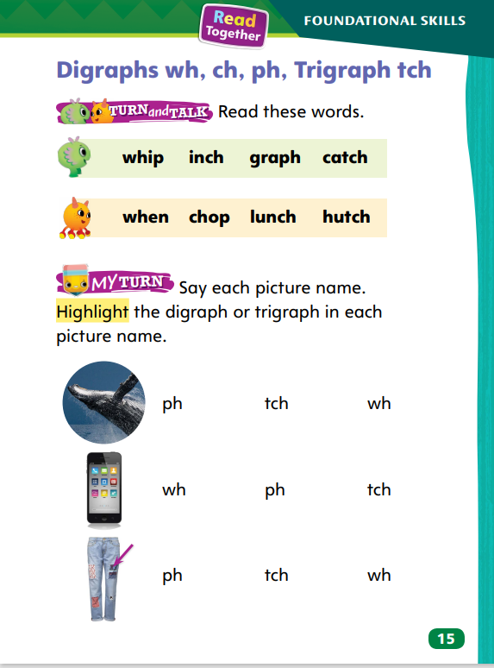
Page 15, 16
Apply
Turn to page 15 in your Student Interactive and read the words.
Say the picture names and write the words.
Read each word.
Turn to page 16. Read the sentences and underline the words with diagraphs.
Write another sentence about Chip and Patch.
Notes:
Have students complete the rest of p. 15 and p. 16 in the Student Interactive.

Slide 23
High-Frequency Words
good
no
put
round
said
Notes:
Write the words good, no, put, round, said.
Have students say and spell each word.
Have students use each word in a sentence.
Have students write the words and practice spelling them with a partner.
Have students take turns dictating and spelling.

Slide 24
Page 26
Preview Vocabulary
stored
begged
gathered
prepared
Notes:
Introduce the words stored, begged, gathered, and prepared from p. 26 in the Student Interactive.
Have students share what they already know about the words. Ask questions such as: Where has your family stored food? What is something you have prepared? Have you ever gathered wood for a campfire? Has your dog ever begged?
Have students mime the action described by the words. For example, they could mime opening the doors of a cabinet, putting something inside, and closing the doors to show stored.
Ask students to use the title, pictures, and vocabulary words to make a prediction about what will happen in the fable The Ant and the Grasshopper.
Provide definitions of the vocabulary words as needed. Definitions appear on the selection pages that follow. These words will help us understand what happens in the fable The Ant and the Grasshopper.

Slide 25
First Read Strategies
Notes:
Discuss the First Read Strategies with students. For this first read, tell students to read for understanding and enjoyment..
Explain the four steps of the first read.
READ Tell students to read or listen as you read the text. During the first read, encourage students just to enjoy hearing the story.
LOOK Tell students that one way to make a prediction is to guess what will happen next by looking at the text features for clues. Text features such as the title and illustrations can give information about the story. Have students use the text features to make a prediction, or guess, about what will happen in the story. Provide assistance as needed. Explain that knowing the genre of a story can help a reader make predictions too.
ASK Have students generate, or ask, questions about the resolution of the story to make sure they understand the outcome and the moral of the fable. Provide assistance as needed.
TALK Guide students to talk to a partner about the moral of the fable.
Students may read the text independently, in pairs, or as a whole class. Use the First Read notes to help students connect with the text and guide their understanding.

Slide 26
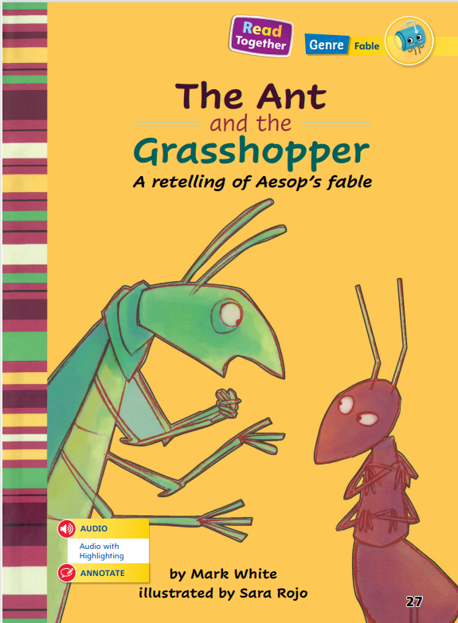
Page 27
First Read – The Ant and the Grasshopper
Notes:
Read Together.
THINK ALOUD When I look at the text features, such as the title and illustrations, I think about what the story will be about. The title makes me think the story will be about the ant and the grasshopper in the picture. The grasshopper looks like it is talking in the picture. I predict, or guess, that the ant and the grasshopper will talk and act like people do.

Slide 27
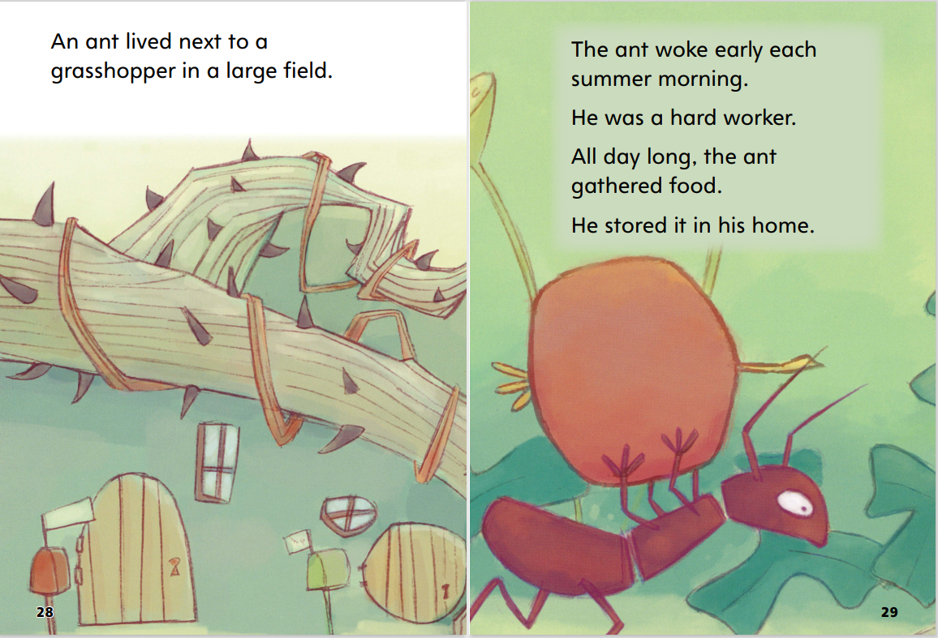
Page 28,29
First Read – The Ant and the Grasshopper
Notes:
Read Together.
THINK ALOUD When I read these first few pages, I can ask myself questions about what I am reading. Why is the ant working so hard and storing food in his home? I can make a prediction, or guess, about the answer. I think the ant works hard and stores food for the winter, when there might not be a lot of food.

Slide 28
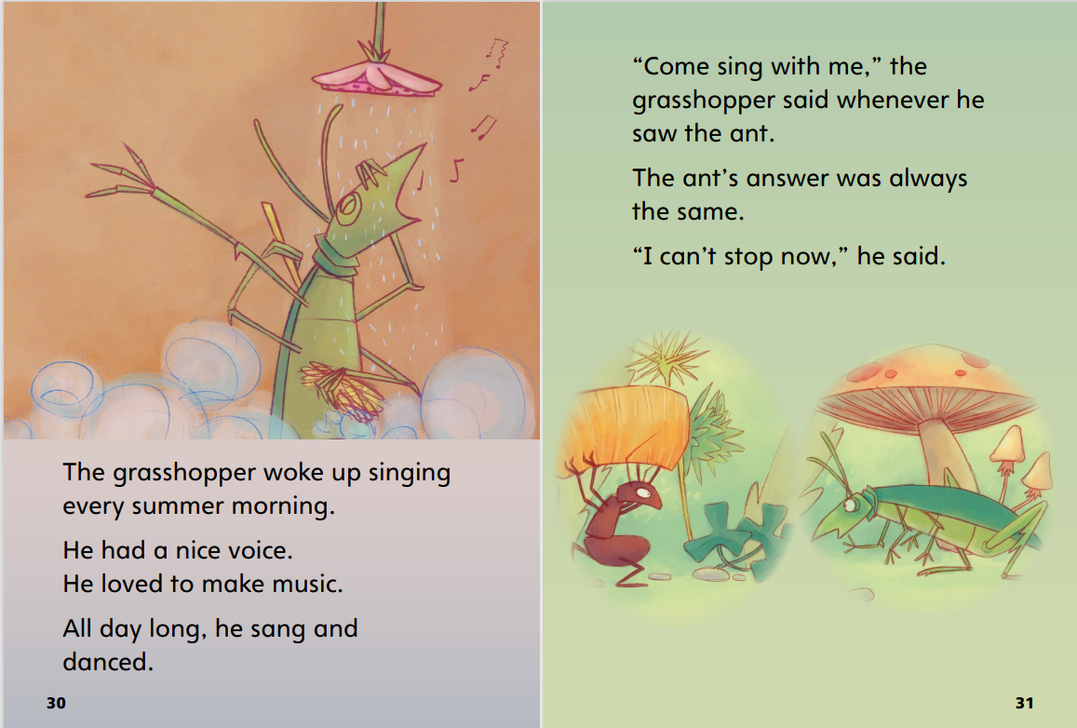
Page 30,31
First Read – The Ant and the Grasshopper
Notes:
Read Together.
THINK ALOUD I read on these pages that the grasshopper likes to sing and dance. I also read that he asks the ant to join him, and the ant always says no. I want to read more to find out what happens next!

Slide 29
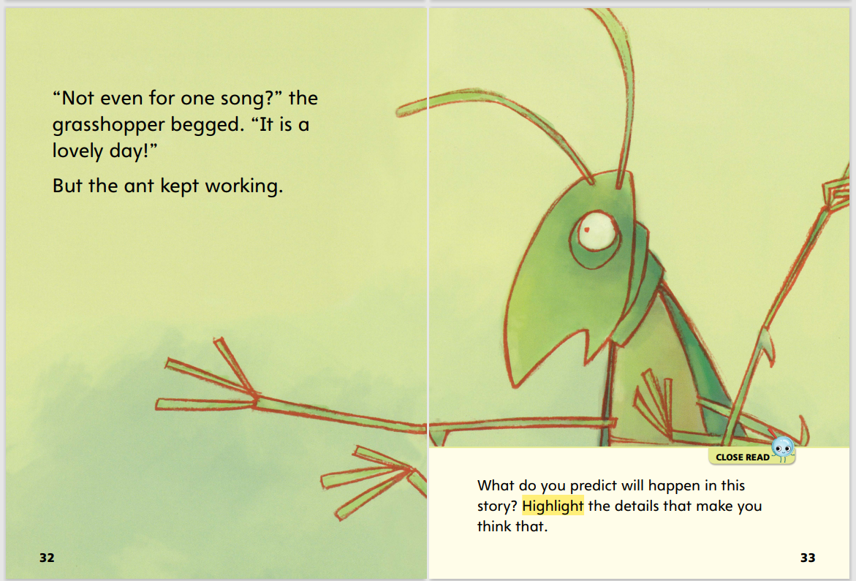
Page 32,33
First Read – The Ant and the Grasshopper
Notes:
Read Together.

Slide 30
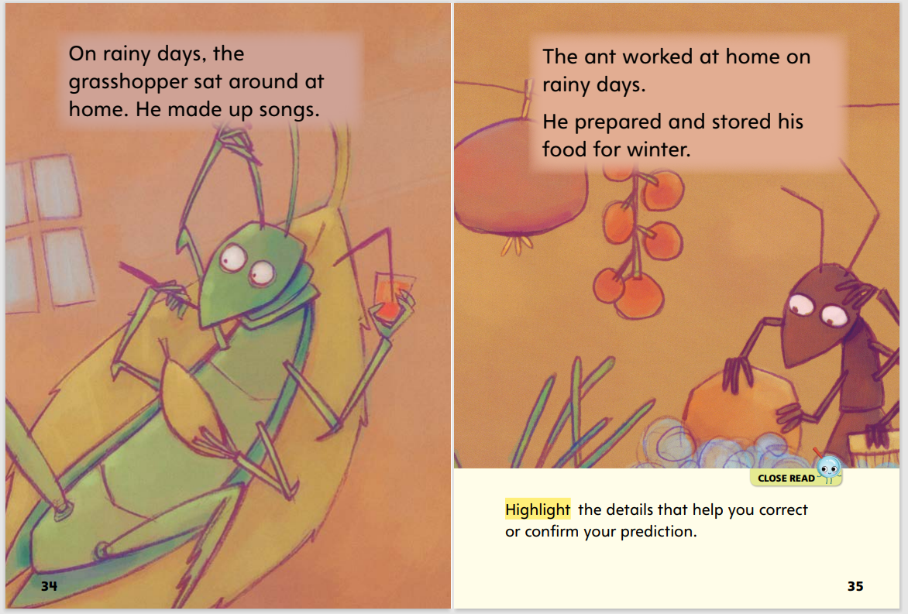
Page 34,35
First Read – The Ant and the Grasshopper
Notes:
Read Together.
THINK ALOUD We can talk about the differences between the grasshopper and the ant. The grasshopper is relaxing on page 34, and the ant is still storing food on page 35. On pages 36–37, the grasshopper is looking for food, but the ant is not working now. It is wintertime.

Slide 31
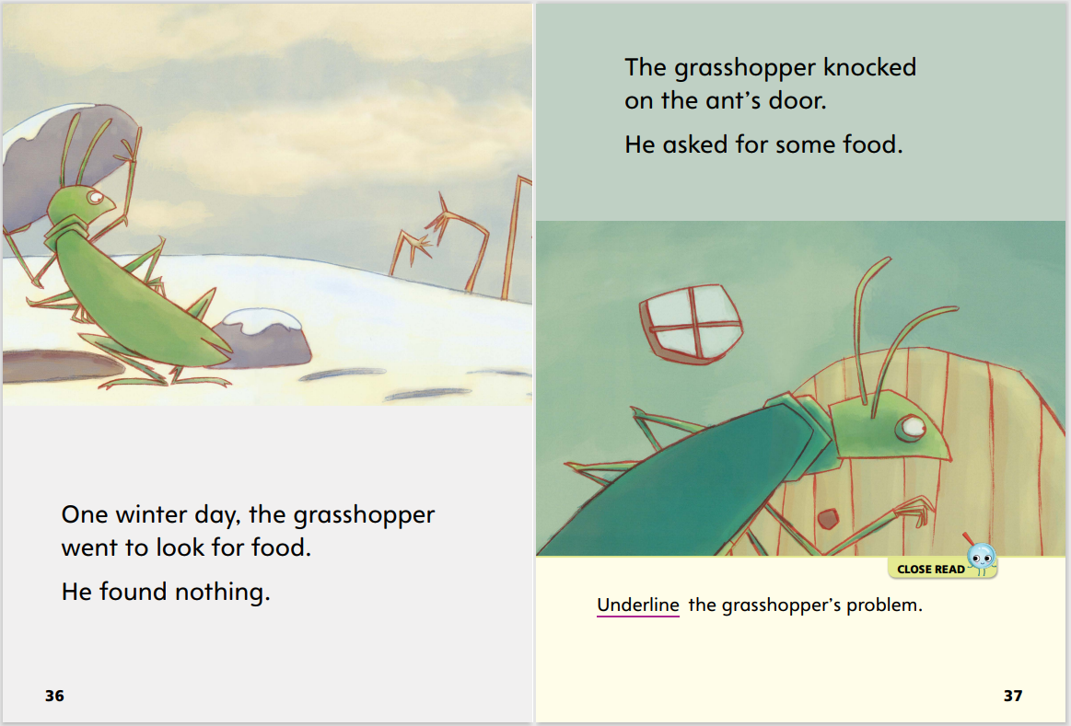
Page 36,37
First Read – The Ant and the Grasshopper
Notes:
Read Together.

Slide 32
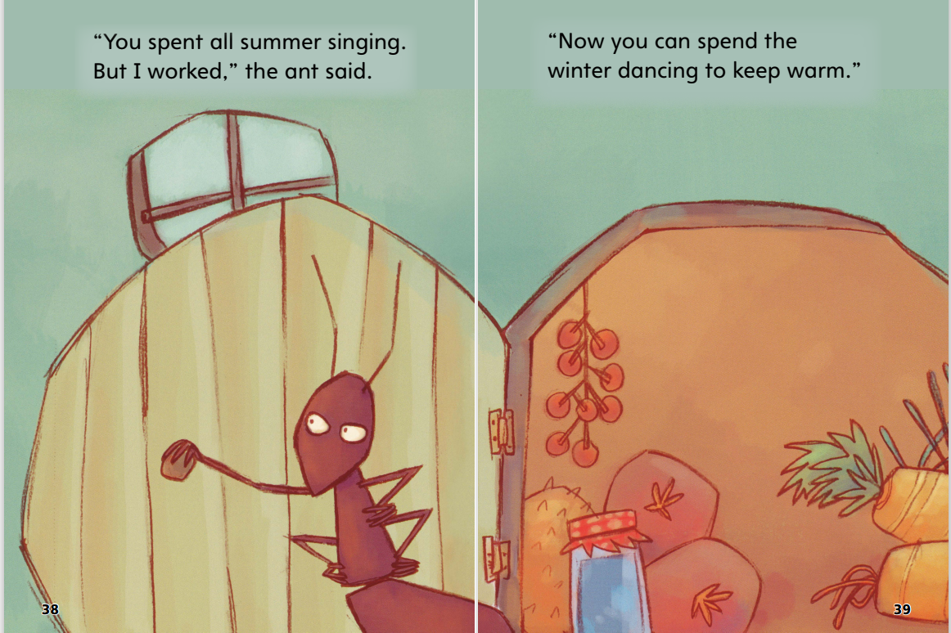
First Read – The Ant and the Grasshopper
Page 38,39
Notes:
Read Together.
THINK ALOUD I want to make sure I understand what has happened in the fable. This will help me understand the resolution, or how the story ends. I can ask some questions to make sure I understand what happened and what the moral, or lesson, of the fable is. What does the ant say to the grasshopper? Why does he answer the grasshopper the way he does? I can go back and look at the earlier parts of the story to find answers.

Slide 33
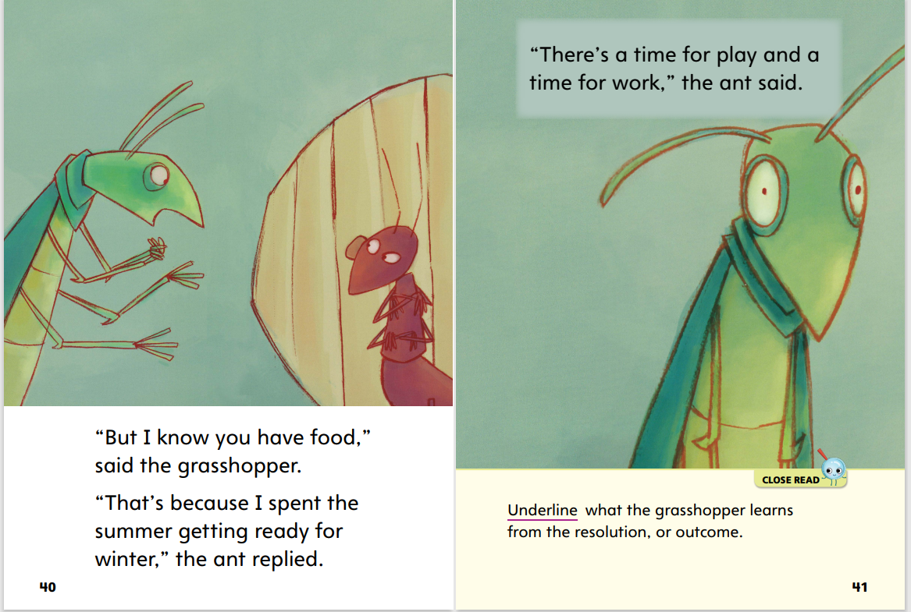
First Read – The Ant and the Grasshopper
Page 40,41
Notes:
Read Together.

Slide 34
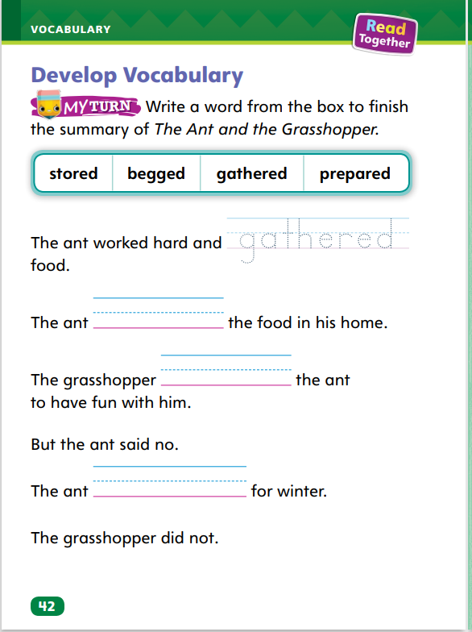
Page 42
Develop Vocabulary
Turn to page 42 in your Student Interactive and complete the activity.
Notes:
Tell students that the vocabulary words stored, begged, gathered, and prepared are action verbs that paint a clear picture of what the characters do in The Ant and the Grasshopper.
Remind yourself of a word’s meaning.
Look for illustrations that help you picture and understand a word.
How does this word help you understand the action in the story?
Have students turn to p. 42 in the Student Interactive. Read the directions aloud. Model how to complete the first sentence. Ask: Which vocabulary word fits best in this sentence?

Slide 35
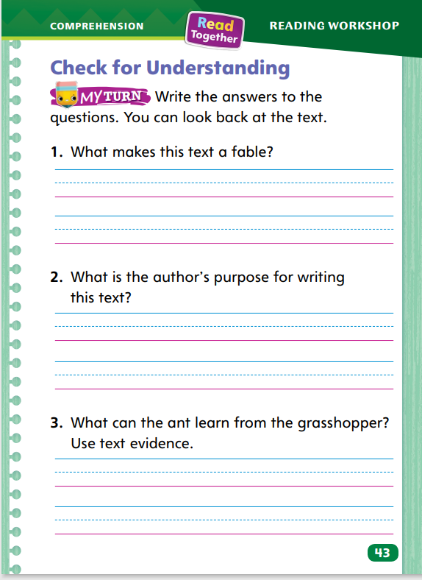
Page 43
Check for Understanding
Turn to page 43 in your Student Interactive and complete the activity.
Notes:
Have students complete p. 43 in the Student Interactive.

Slide 36
Page 51
Writing – Poetry
Turn to page 51 in your Student Interactive.
Notes:
Poetry sounds different from fiction or nonfiction.
Poets use rhythm, repetition, and alliteration to give their poems a certain sound.
Some poems rhyme, and some do not.
Reread the poem on p. 51 in the Student Interactive. Ask students how they know this is a poem. How does it sound different from a story? Point out that a poem sounds different because it has a rhythm, or beat. Then say: What do you think of the words splash, splotch, and splatter? Are they an example of repetition, rhyme, or alliteration? What sounds are the same in these words? Do they make the poem fun to read? Do they make it more interesting? Can you think of other words the poet could use?
As you read more poems from your stack together, ask students to identify examples of alliteration, repetition, and rhyme. The following may be used to prompt discussion:
Does this poem rhyme? Which words rhyme?
Why do you think the poet repeats the word ___? If you read the poem again and only read this word once, is the poem as good?
Do any words begin with the same sounds?

Slide 37
Independent Writing
Begin to write your poem.
Share an example of alliteration, repetition, and rhyme.
Notes:
If students need additional opportunities to develop their understanding of poetry, they should read additional poems from the stack. If students demonstrate understanding, they should begin writing their poems.
Select a few students to share examples of alliteration, repetition, and rhyme from a stack book or from a poem they are writing.

Slide 38
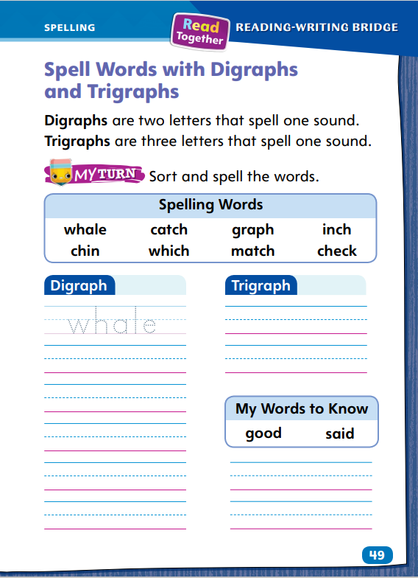
Page 49
Spelling
when
chest
Steph
Turn to page 49 in your Student Interactive and complete the activity.
Notes:
Select a few students to share examples of alliteration, repetition, and rhyme from a stack book or from a poem they are writing.
Display the words when, chest, and Steph. Say each word aloud and underline the digraph. Repeat with the word match and underline the trigraph.
Have students complete p. 49 in the Student Interactive independently.

Slide 39
Language and Conventions
The plants in the yard look beautiful.
Which word names one thing?
Which word names more than one thing?
How do you know?
Work with your partner using singular and plural nouns to make sentences.
Notes:
Flexible Option
Answer questions students may have about nouns. Then introduce singular and regular plural nouns. Explain that a plural noun names more than one. We often add -s to make a plural noun.
Display and read aloud this sentence: The plants in the yard look beautiful.
Ask: Which word names one thing? (yard) That means yard is a singular noun. Which word names more than one thing? (plants) How do you know the word plants names more than one thing? (an s was added at the end of the word plant) The -s means plants is a plural noun.
Have student pairs share oral sentences with one another using both singular and plural nouns.

Slide 40
Lesson 3

Slide 41
Page 17
Phonological Awareness
Notes:
Point to the picture of the check (mark) at the top of p. 17 in the Student Interactive.
Say: This is a picture of a check. Let’s say the sounds in check together: /ch/ (pause) /e/ (pause) /k/.
Then have students repeat with the words bench (/b/ /e/ /n/ /ch/) and wheel (/hw/ /ē/ /l/).
Say the following words and have students segment and blend the phonemes: lunch, can’t, phone, hatch, it’s, white, whip.

Slide 42
Page 17
Phonics
can not
can’t
he is
he’s
I am
I’m
Turn to page 17 in your Student Interactive and complete the activity.
Notes:
Explain that contractions are made up of two words that have been shortened into one.
Write I’ll on the board and point to the apostrophe. Say: The missing letter or letters in contractions are replaced with an apostrophe. I’ll is the contraction for the words I will.
Write I will on the board. Display Sound-Spelling Card 110 (she’ll). Say: If I’ll is the contraction for I will, for what words is she’ll the contraction? (she will).
Write or display these words and their contractions: can not (can’t); he is (he’s); and I am (I’m). Point to can not and read the words. Then point to can’t and read the word. What two letters are missing? (n and o) What takes the place of the missing letters? Yes, an apostrophe. Let’s read the other words.
First model writing the two words he and is and reading the words. Erase the letter i, replace it with an apostrophe, and read the word he’s. Repeat the process with I and am and other words and their contractions, such as she will, she’ll; they will, they’ll; does not, doesn’t, and is not, isn’t.
Have students decode the words and highlight the apostrophes on the bottom of p. 17 in the Student Interactive.

Slide 43
Page 18
High-Frequency Words
good
no
put
round
said
Turn to page 18 in your Student Interactive and complete the activity.
Notes:
Tell students that high-frequency words are words we learn by remembering the letters in the words rather than saying the sounds. Tell them there are three good ways to learn the words: say the word, spell the word, and use the word in a sentence.
Display this week’s words: good, no, put, round, said. Have students use the words in sentences.
Then have students turn to the top of p. 18 in the Student Interactive and read the words.
Direct students to the bottom of p. 18. Have them print the high-frequency words to complete the sentences.

Slide 44
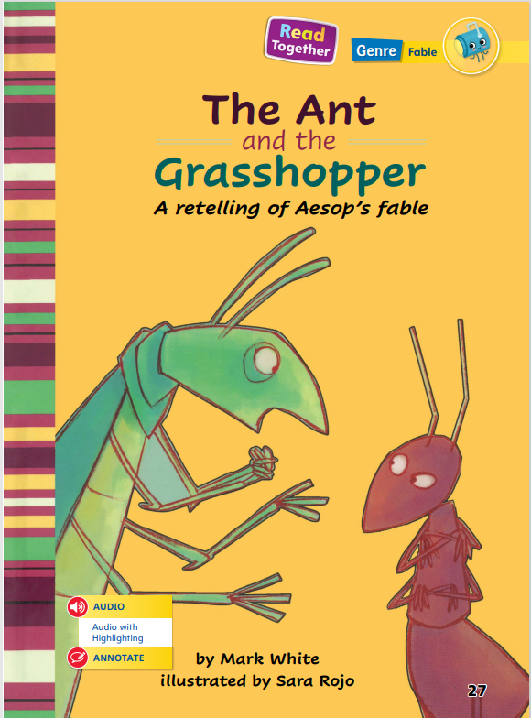
Page 27
Describe Plot
Notes:
The plot, or main events, of a story includes a problem or challenge the characters have. How this problem is solved is called the resolution. In a fable, readers learn the moral, or lesson, of the story at the resolution.
Think about the story. What happens first? Next? Last?
Note the problem or challenge that the characters have.
How was the problem solved?
Use the Read Aloud “The Lion and the Mouse” on pp. T34–T35 to model describing the plot. Say: In “The Lion and the Mouse,” the first event is when Lion finds Mouse and then decides to let him go. Next, Lion is trapped in a net. This is the problem in the story. Finally, Mouse chews through the net, and Lion is free. This is how the problem is solved, which is called the resolution, or outcome.
Have students look at the illustrations on pp. 40–41 in the Student Interactive to find details about the plot.
Then, have students go back to the Close Read notes on pp. 37 and 41 in the Student Interactive and underline the problem and the lesson learned.

Slide 45
Page 40, 41
Close Read – Describe Plot
Notes:
Use the Read Aloud “The Lion and the Mouse” on pp. T34–T35 to model describing the plot. Say: In “The Lion and the Mouse,” the first event is when Lion finds Mouse and then decides to let him go. Next, Lion is trapped in a net. This is the problem in the story. Finally, Mouse chews through the net, and Lion is free. This is how the problem is solved, which is called the resolution, or outcome.
Have students look at the illustrations on pp. 40–41 in the Student Interactive to find details about the plot.
Then, have students go back to the Close Read notes on pp. 37 and 41 in the Student Interactive and underline the problem and the lesson learned. DOK 2

Slide 46
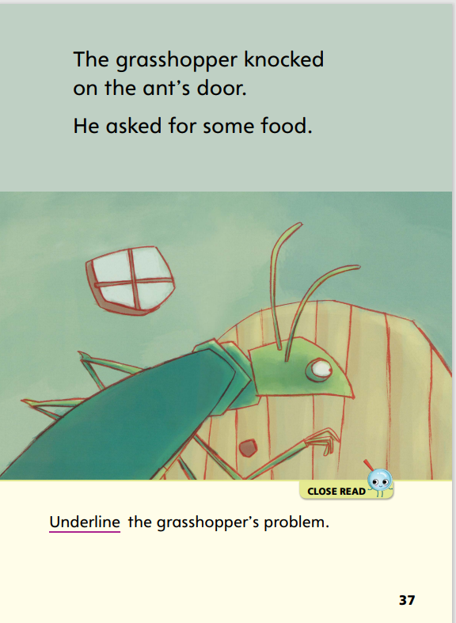
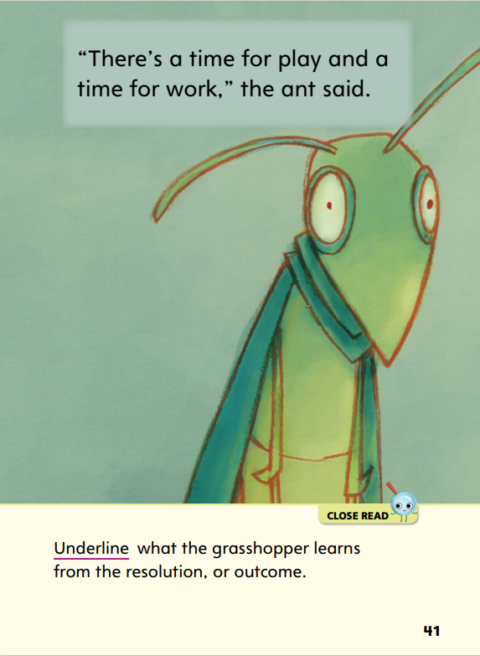
Page 37, 41
Close Read – Describe Plot
Notes:
Then, have students go back to the Close Read notes on pp. 37 and 41 in the Student Interactive and underline the problem and the lesson learned.
Remind students that the problem in a story’s plot, or main events, is what needs to be solved. Have students underline the text on p. 37 that tells the grasshopper’s problem. DOK 2
Have students read the Close Read note on p. 41. Ask them what lesson the grasshopper learned from the resolution. (There’s time for work and time for play.) Have them underline the part of the text where they found this detail. DOK 2

Slide 47
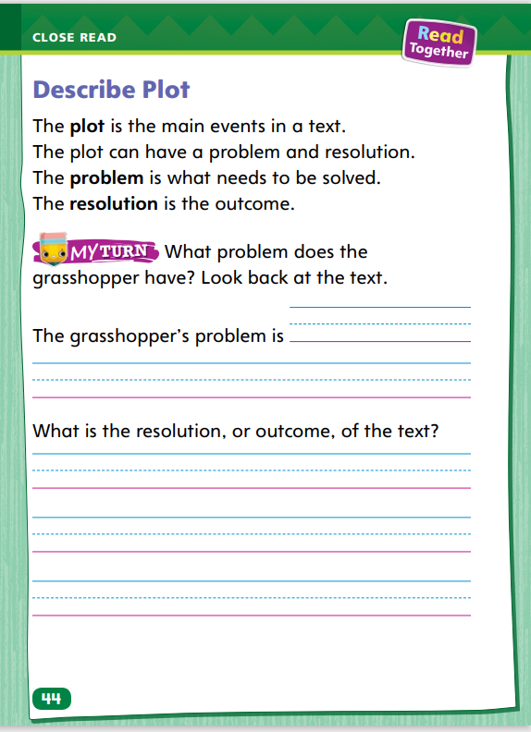
Page 44
Describe Plot
Turn to page 44 in your Student Interactive and complete the activity.
Notes:
Have students use the strategies for describing plot elements.
Have students complete p. 44 in the Student Interactive.

Slide 48
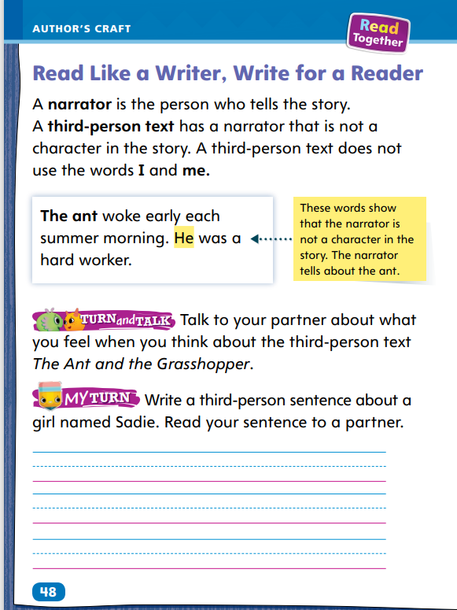
Page 48
Read Like a Writer, Write Like a Reader
Turn to page 48 in your Student Interactive.
Notes:
When a story is told by someone who is not a character in the story, it is called a third-person text. Readers can listen to a third-person text and then experience it by picturing the story in their minds.
Ask yourself from whose point of view the story is being told. In a third person text, the story is told from the point of view of someone who is not a character in the story, or a narrator.
The narrator will use words such as he, she, or them.
Model listening to and experiencing third-person text using the example on p. 48 in the Student Interactive: When I read the sentence “The ant woke early each summer morning,” I notice that the ant is not telling the story. Someone outside the story is the narrator, so this is a third-person text. I can picture in my mind the ant waking up before the sun rises.
Have students listen to a sentence from a third-person text and then tell how they experience the text.
Have students complete the activities on p. 48 in the Student Interactive.

Slide 49
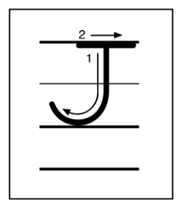
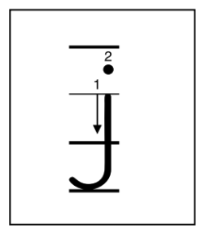
Handwriting
Notes:
Display uppercase and lowercase letters Jj.
Model how to write uppercase J using correct letter formation and slant. Have students practice writing the letter in the air with their fingers. Then repeat with lowercase j.
Write the words jump, jot, jug, Jim, Jen, and Jack, showing proper letter formation and correct letter size. Have students use appropriate spaces between words.
Have students use Handwriting p. 156 from the Resource Download Center to practice writing the uppercase and lowercase letters Jj. Click path: Table of Contents -> Resource Download Center -> Handwriting Practice -> U3W1L3 Handwriting Practice

Slide 50
Writing – Poetry
Poems are:
organized into lines and stanzas.
sometimes written win the shape of the thing are about.
sometimes written with no punctuation.
Notes:
Poems do not look like fiction or nonfiction texts. Poems are:
organized into lines and stanzas.
sometimes written in the shape of the thing they are about.
sometimes written with no punctuation.
Select several poems from the stack. Include at least one shape poem, one with limited punctuation, and one organized in stanzas. Display one of the poems.
Show the other poems you have selected. You might also show examples of prose for comparison. Use the following questions to prompt discussion:
Is this a poem? How do you know?
Tell me about the punctuation in this poem.
Does this poem have a special shape? What is the poem about?
Next, discuss the structure. Listen as I read this without pausing at the ends of lines. Then listen as I read it with the pauses. Which way is better? How does paying attention to new lines help you know how to read a poem?

Slide 51
Writing – Poetry
Is this a poem?
Tell me about the punctuation in this poem.
Does this poem have a special shape?
What is the poem about?
Notes:
Poems do not look like fiction or nonfiction texts. Poems are:
organized into lines and stanzas.
sometimes written in the shape of the thing they are about.
sometimes written with no punctuation.
Select several poems from the stack. Include at least one shape poem, one with limited punctuation, and one organized in stanzas. Display one of the poems.
Show the other poems you have selected. You might also show examples of prose for comparison. Use the following questions to prompt discussion:
Is this a poem? How do you know?
Tell me about the punctuation in this poem.
Does this poem have a special shape? What is the poem about?
Next, discuss the structure. Listen as I read this without pausing at the ends of lines. Then listen as I read it with the pauses. Which way is better? How does paying attention to new lines help you know how to read a poem?

Slide 52
Independent Writing
Explain the structure of the poem you read.
You will continue to work on your poem.
Notes:
If students need additional opportunities to develop their understanding of poetry, they should read additional poems from the stack. If students demonstrate understanding, they should continue writing their poems.
If students struggle, choose one of the following options to provide further support.
Modeled - Choose a stack text and do a Think Aloud to model discussing text structure.
Shared - Have students choose a stack text. Prompt students to discuss how the structure of the poem works.
Guided - Use the stack texts to provide explicit instruction on how structure affects a poem.
Call on a few students to explain or discuss the structure of a poem they have read.

Slide 53
Spelling
whale
catch
inch
which
match
check
Notes:
Flexible Option
Remind students that in words with consonant digraphs and trigraphs, two or more consonants spell one sound together rather than separate sounds.
Display and read aloud the spelling words, emphasizing the sound created by the digraphs or the trigraph -tch. Call on volunteers to circle the correct letters for each digraph or trigraph.
Have students complete Spelling p. 165 from the Resource Download Center. Click path: Table of Contents -> Resource Download Center -> Spelling -> U3W1

Slide 54
Language and Conventions
We will name items in our classroom that are nouns.
Then we will discuss items that are singular and items that are plural.
Notes:
Explain that a singular noun names only one person, animal, place, or thing. A plural noun names more than one person, animal, place, or thing. Review that many plural nouns are formed by adding -s or -es to the singular form of the noun. When a noun ends in x, ch, sh, s, z, or ss, the ending -es is added to make it a plural noun.
To reinforce singular and plural nouns, name items in the classroom that are nouns—such as desk, pencils, board, chairs, books, and computer—and call on students to tell whether each is singular or plural. Then ask volunteers to provide other examples of singular and plural nouns they see around them

Slide 55
Lesson 4

Slide 56
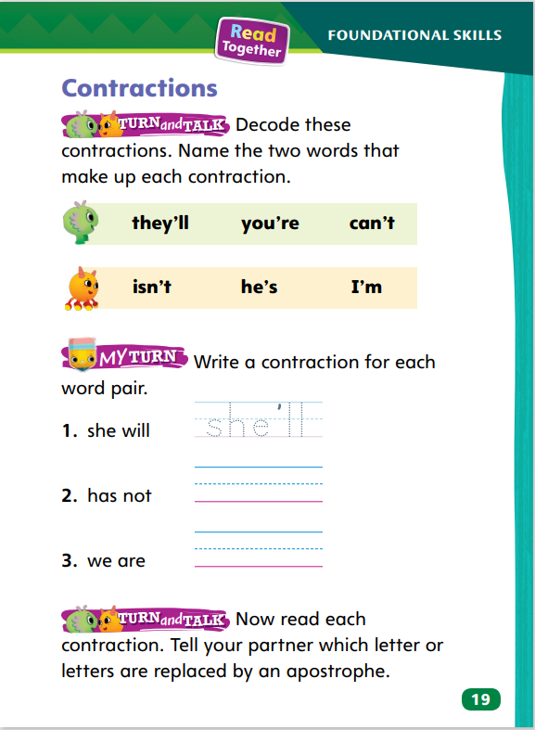
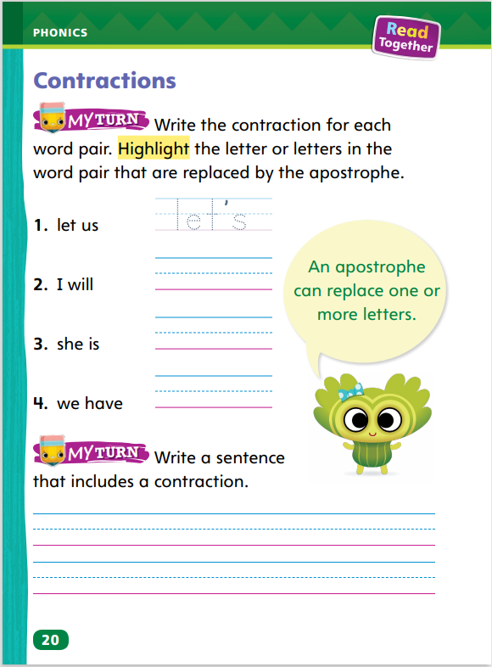
Page 19, 20
Phonics
she will
shell
Turn to page 19 in your Student Interactive.
Notes:
Tell students that a contraction is a shortened form of two words. Explain that an apostrophe replaces the missing letter or letters.
Write she will on the board. Model how you delete (erase) the w and the i in will and join ll to she with an apostrophe.
Display the word shell. Ask students to read the word. Say: Without an apostrophe, the letters s-h-e-l-l spell the word shell. If you are writing a contraction, don’t forget to put in the apostrophe for the missing letters.
Have partners read the words at the top of p. 19 in the Student Interactive.
Have students complete the rest of p. 19 and p. 20 in the Student Interactive.

Slide 57
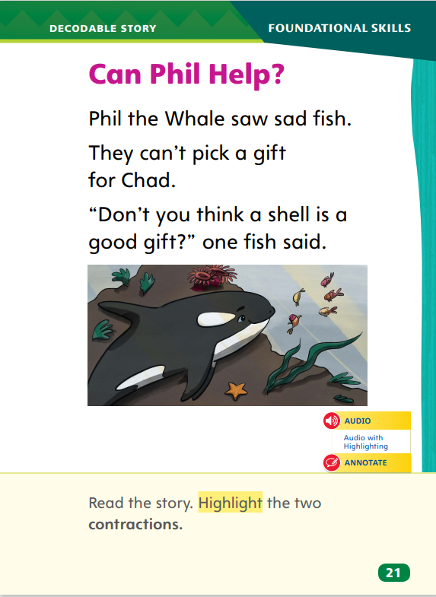
Page 21
Decodable Story
Turn to page 21 in your Student Interactive. Read “Can Phil Help?” with your partner.
Notes:
Have students turn to p. 21 in the Student Interactive.
Say: We are going to read a story today about a whale and some fish. Point to the title of the story. The title of the story is Can Phil Help? Tell students they will be reading words with digraphs, trigraphs, and contractions in this story.
Before reading, review this week’s high-frequency words: good, no, put, round, said. Display the words. Have students read them with you. Tell them that they will also practice reading the high-frequency words in the story Can Phil Help?
Pair students for reading and listen carefully as they use letter-sound relationships to decode. One student begins. Students read the entire story, switching readers after each page. Partners reread the story. This time the other student begins.
Have students turn to p. 21 in the Student Interactive. Say: Which words are contractions? Students should supply the words can’t and don’t. Have them highlight the words.

Slide 58
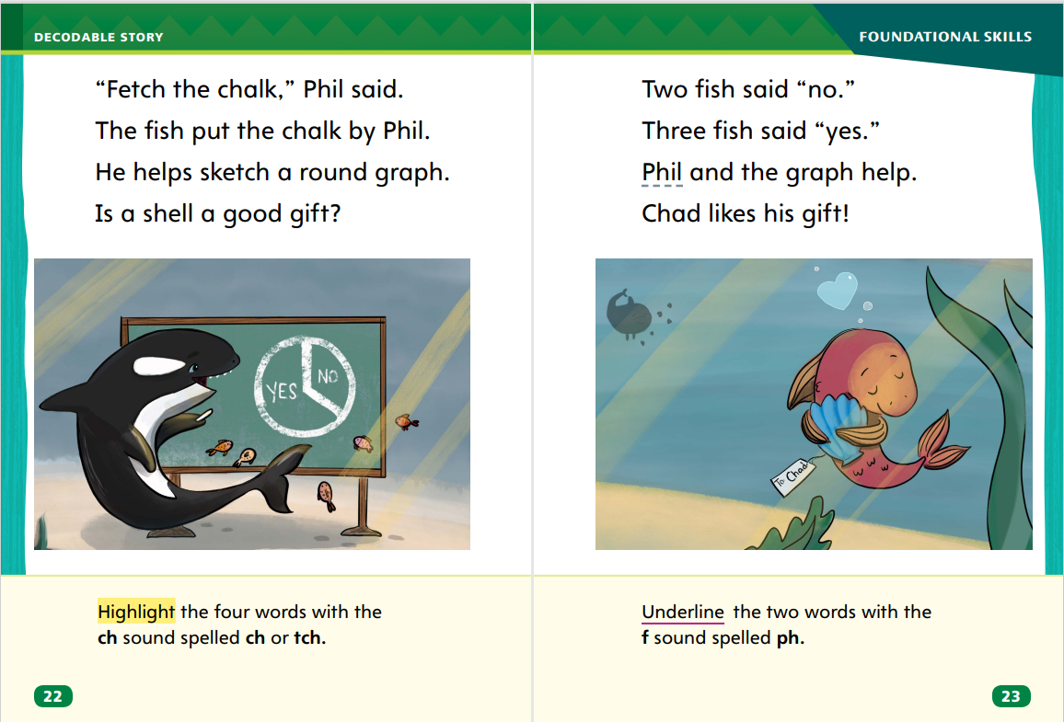
Page 22,23
Decodable Story
Notes:
Have students turn to p. 22. Say: Which words have the sound /ch/? Students should supply the words fetch, chalk, and sketch. Then ask: Which letters spell the sound /ch/ in these words? Students should say ch and tch. Have students highlight the words.
Have students turn to p. 23. Say: Which words have the sound /f/? Students should supply the words Phil and graph. Then ask: Which letters spell the sound /f/ in these words? Students should say ph. Have them underline the words.

Slide 59
Page 27
Correct and Confirm Predictions
Identify the genre of the text.
As you read, look for characteristics of the genre to tell if your prediction is right.
Correct or Change your prediction based on what you learn as you read.
Notes:
Tell students that a prediction is a guess about something that might happen in a text. Readers can use characteristics of genre to correct or confirm their predictions.
Identify the genre of the text. Use what you know about the genre to make a prediction about what might happen in the text.
As you read, look for characteristics of the genre that tell you if your prediction was right.
If the characteristics of the genre show that your prediction does not match what happens, you can correct, or change, your prediction based on what you learn as you read.
Direct students to turn to p. 27 in the Student Interactive. Say: I know that this story is a fable. Fables have animals that talk and act like people. So, I predict that the ant and the grasshopper talk and act like people. As I read, I will check my prediction and change it if I need to.
Have students go back to the Close Read notes on pp. 33 and 35 in the Student Interactive and highlight text that helps them make and correct or confirm a prediction.

Slide 60
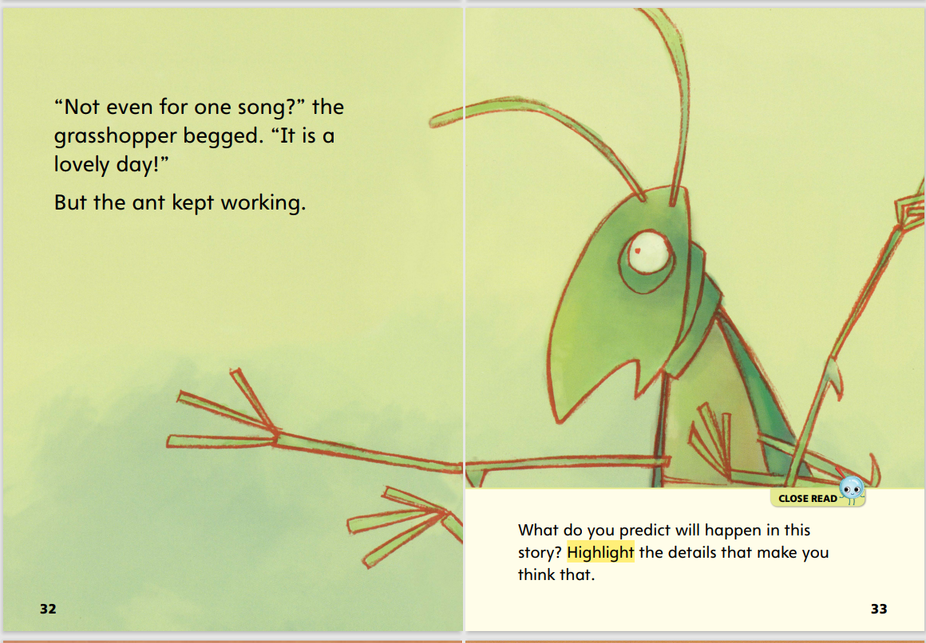
Page 33
Close Read – Correct and Confirm Predictions
Notes:
Read the Close Read note on p. 33. Prompt students to predict, or guess, what will happen. Have them highlight the details in the text that support their prediction. DOK 2.

Slide 61
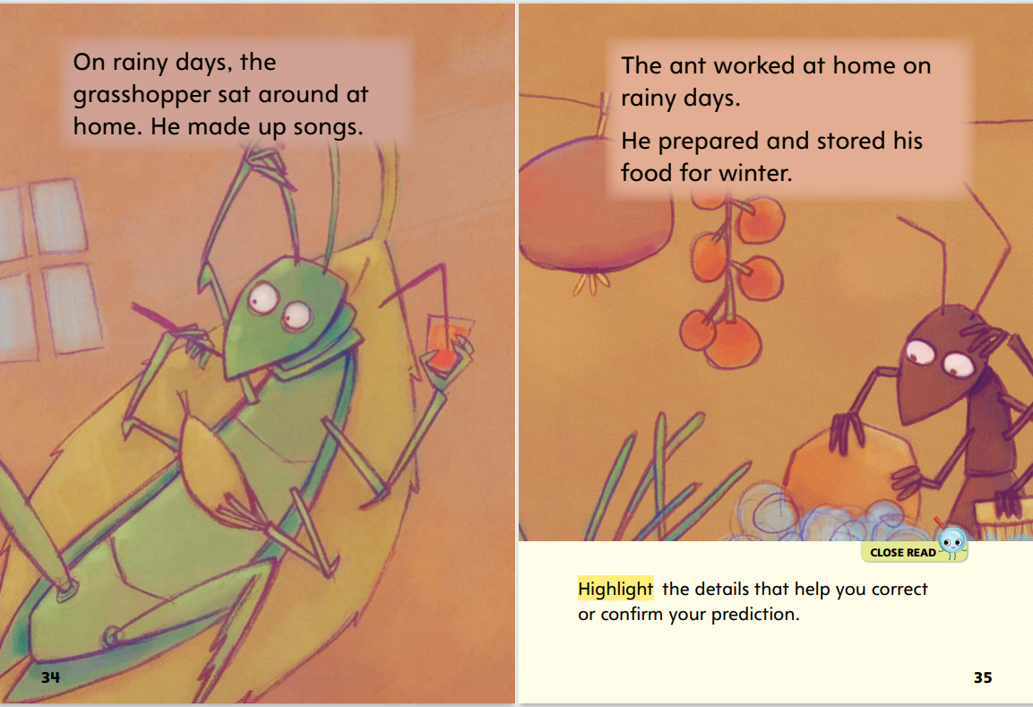
Close Read – Correct and Confirm Predictions
Page 34,35
Notes:
Have students highlight the text details on pp. 34–35 that they use to change or confirm their predictions. DOK 2.

Slide 62
Page 45
Correct and Confirm Predictions
Turn to page 45 in your Student Interactive and complete the activity.
Notes:
Have students use the strategies for using the characteristics of genre to make, correct, and confirm predictions about a story.
Have students complete p. 45 in the Student Interactive.

Slide 63
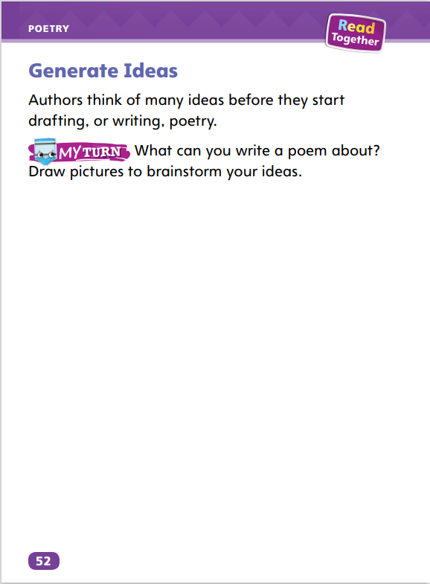
Page 52
Writing – Poetry
Turn to page 52 in your Student Interactive.
Notes:
Ideas are everywhere. Poets generate, or come up with, many ideas. Then they choose the best one.
A poem can be about anything or anyone.
A poem can describe something.
A poem can tell a story.
Show several poems from the stack that you have read together. Ask students to tell what each poem is about.
Do you remember this poem? What is this poem about?
Where do you think the poet got the idea for this poem?
Is this a good idea for a poem?
Tell students to turn to p. 52 in the Student Interactive. Read the introduction and directions aloud. Let students know that they will have many opportunities to write poetry, so they should draw several ideas. Use the following prompts to help students generate ideas:
Remember that there are no bad ideas.
Remember that a poem can be about anything.
Draw a picture of a person who is interesting or important to you.
Draw a picture of your favorite animal.
Draw a picture of an interesting object or situation.
Draw a picture of your favorite place.

Slide 64
Independent Writing
Brainstorm as many ideas as you can.
You can either continue to work on your poem or write a new poem.
Notes:
Students should generate as many ideas as they can for their own writing. Then they should go back to their poems and continue writing or write a new poem. Tell students to keep their brainstorm ideas in a folder so they can refer to them at a later date.
As students write, use the conference prompts in the Teacher’s Edition or Resource Download Center to provide support. Click path: Table of Contents -> Resource Download Center -+ Writing Workshop Conference Notes
Have a few students share their ideas and tell how they chose them.

Slide 65
Spelling
same
rake
cape
made
lane
Underline the a_e pattern in each word.
Notes:
Flexible Option
Have students recall the spelling rules for words with long a spelled a_e.
Read the following words and have students spell them: same, rake, cape, made, lane.
Have pairs work together to identify and underline the a_e pattern in each word.

Slide 66
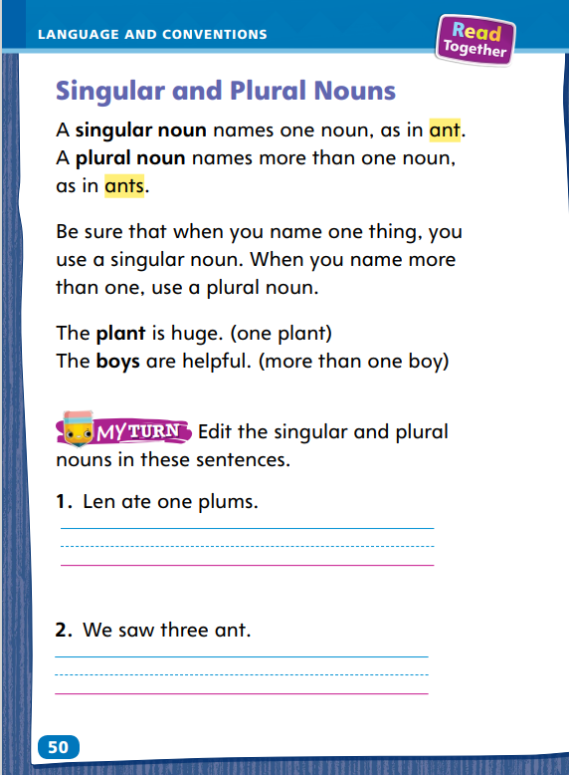
Page 50
Language and Conventions
Turn to page 50 in your Student Interactive and complete the activity.
Notes:
Have students complete p. 50 in the Student Interactive.

Slide 67
Lesson 5

Slide 68
Phonological Awareness
cat
pal
tack
lap
pin
lid
nip
dill
Notes:
Move the orange circles into the table to represent each phoneme in the modeled examples.
Tell students that when you manipulate sounds in a word, you move, or switch, the sounds to different places. Say: I am going to show you how to manipulate the sounds in a word. Let’s say the sounds in cat: /k/ /a/ /t/. Now let’s switch the first sound, /k/, and the last sound, /t/: /t/ /a/ /k/, tack.
Have students manipulate the phonemes in each word to say a new word: pal /p/ /a/ /l/ to lap /l/ /a/ /p/; pin /p/ /i/ /n/ to nip /n/ /i/ /p/; lid /l/ /i/ /d/ to dill /d/ /i/ /l/.

Slide 69
Phonics
Mike is nice.
Look at his face.
What is his age?
Mike is five.
Notes:
Use Sound-Spelling Cards 4 (cereal), 9 (giraffe), and 80 (lime) to review the sound /s/ spelled c, the sound /j/ spelled g, and long i spelled i_e.
Write the sentences below. Model decoding and reading the first sentence. Then have partners decode and read the remaining sentences.
Mike is nice.
Look at his face.
What is his age?
Mike is five.

Slide 70
High-Frequency Words
good
no
put
round
said
Notes:
Tell students that high frequency words are words that they will hear and see over and over in texts. Write the words good, no, put, round, and said.
Have students work with a partner.
One student spells a word.
The other student says the word.
Repeat.

Slide 71
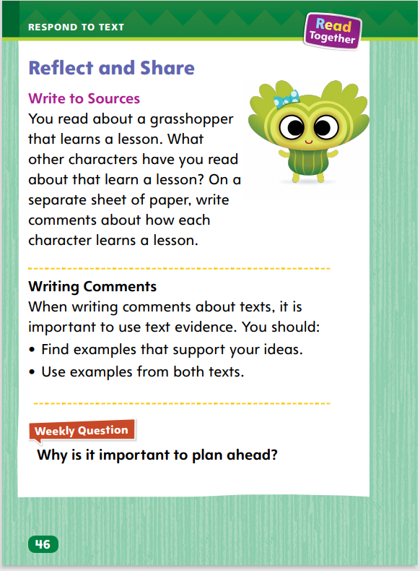
Page 46
Reflect and Share
Turn to page 46 in your Student Interactive.
Notes:
Tell students that sometimes they will write brief, or short, comments to compare two or more texts. When they write, they should use text evidence to support their response. Students should
look for how the texts are similar or different.
use evidence from both texts.
write comments in complete sentences.
Model writing brief comments about characters who learn a lesson, using the Write to Sources prompt on p. 46 in the Student Interactive. Say: The grasshopper learned a lesson about planning and being prepared. That reminds me of a story I read about a girl who always forgot her school things. Just like the grasshopper, the girl had to learn a lesson about coming to school prepared. I will write The grasshopper and the girl learn different lessons.
Ask students to help write brief comments about the grasshopper.

Slide 72
Page 42
Apply
Use evidence from this week’s text to discuss how different characters have learned lessons.
Notes:
Have students use the strategies for comparing texts through writing.
Use the Shared Read Have students use text evidence from this week’s texts to make connections about how different characters have learned lessons.
Have students use evidence from the texts they have read this week to respond to the Weekly Question. Tell them to discuss responses with a partner.

Slide 73
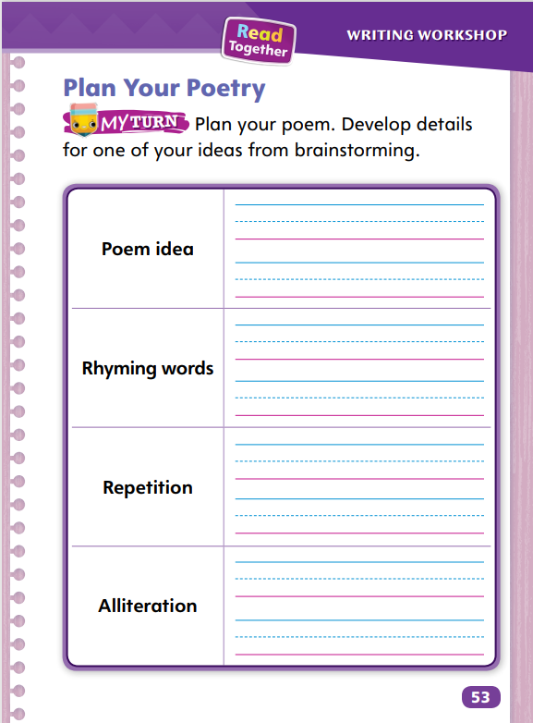
Page 53
Writing – Poetry
Turn to page 53 in your Student Interactive.
Notes:
Poets plan a poem before they begin writing it. They think about their topic and how they can best tell about it or describe it. They think about elements of poetry they can use, such as sound and structure.
Name an object or a topic you might write about in a poem, for example, the rain. Say: I have decided to write about rain. What are some words that rhyme with rain? Lane, main, and pane. I’ll try to use at least one of those in my poem. What sound does rain make? It makes the sound plip plop, plip plop. I can repeat that sound in my poem. Now I will think of words that begin with the same beginning sounds. I can write about rain using more words that begin with the letter r. In my poem, I can use words like roaring, rattling, and rooftops.
Tell students to turn to p. 53 in the Student Interactive. Read the directions aloud. Use the following prompts to help students plan their poem.
Look at your list of ideas and choose the one you want to write about.
Write words that describe it.
Now write words that rhyme with those words.
Which words are important? Is there a word you might want to repeat?
Look at your first list of words. Are there words that begin with the same sounds? Can you use one or more of them?
Call on a few students to share their ideas about how they might use rhyming words, repeating words, or alliteration in their poem.

Slide 74
Spelling
1. This is a very good book.
2. I saw a whale when I was at the aquarium.
3. Can you make a graph to show the votes?
4. Lin bumped her chin on the table.
5. Thad said he would come for a visit.
6. I don’t know which fruit to choose.
7. These socks do not match.
8. She grew an inch last month.
9. Bea can catch a baseball.
10. We should check the weather before going outside.
Notes:
(Note: Move the orange boxes to cover each bold spelling word before you read aloud the words and sentences.)
Read aloud the words and sentences. Have students spell the words with consonant digraphs wh, ch, -ph, consonant trigraph -tch, and high-frequency words they have been practicing this week.
This is a very good book.
I saw a whale when I was at the aquarium.
Can you make a graph to show the votes?
Lin bumped her chin on the table.
Thad said he would come for a visit.
I don’t know which fruit to choose.
These socks do not match.
She grew an inch last month.
Bea can catch a baseball.
We should check the weather before going outside.
Reveal the spelling word and have students check their work.

Slide 75
Language and Conventions
Sasha drew a picture of a tree full of apples.
Which word is an example of a plural noun?
Sasha
picture
tree
apples
Notes:
Flexible Option
Display the following sentence and guide students to complete the question.
Sasha drew a picture of a tree full of apples.
Which word in the sentence is an example of a plural noun?
A Sasha
B picture
C tree
D apples
Have students complete Language and Conventions p. 171 from the Resource Download Center. Click path: Table of Contents -> Resource Download Center -> Language and Conventions -> U3 W1

Slide 76
Unit 3: Week 1
Grade 1

